Slide 1
Automobile Data Analysis
This presentation is a summary of the analysis of automobile data.

Slide 2
Summary Statistics
This slide shows the summary statistics of the automobile data.

Slide 3
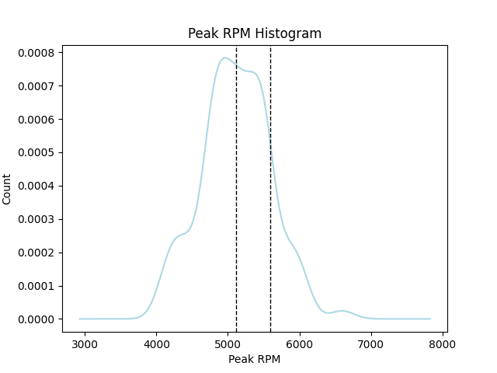
Histogram and Boxplot

Slide 4
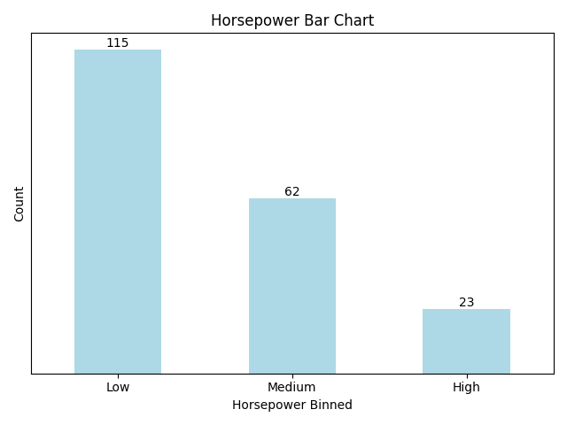
Bar Chart

Slide 5
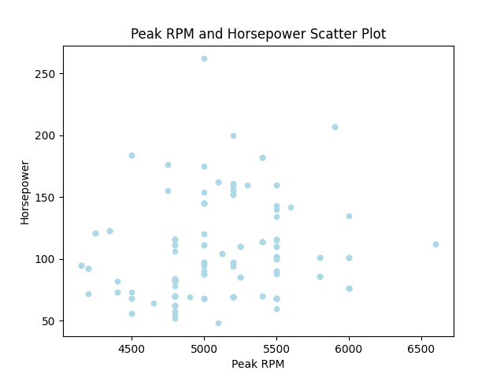
Scatter Plot

Slide 6
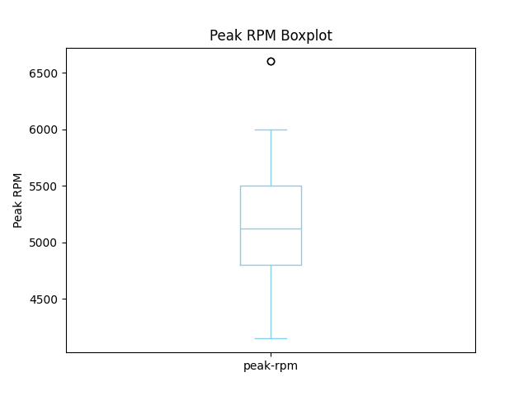
Boxplot

